Slide 1
24
7
30
Fractions
Date
EQ – What are the different methods for adding and subtracting fractions?
$$What are the 2 methods we have used so far?$$

Slide 2
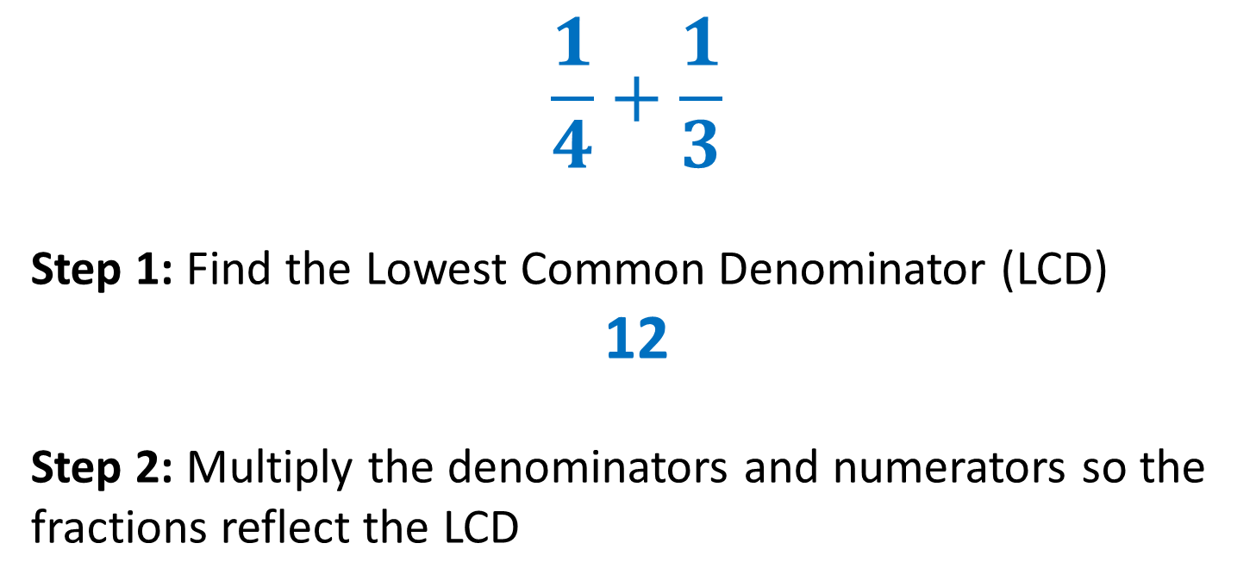
24
7
30
Fractions
Date
EQ – What are the different methods for adding and subtracting fractions?
Finding the Lowest Common Denominator
$$\frac{1}{4}+\frac{1}{3}$$
Step 1: Find the Lowest Common Denominator (LCD)
12
Step 2: Multiply the denominators and numerators so the fractions reflect the LCD

Slide 3
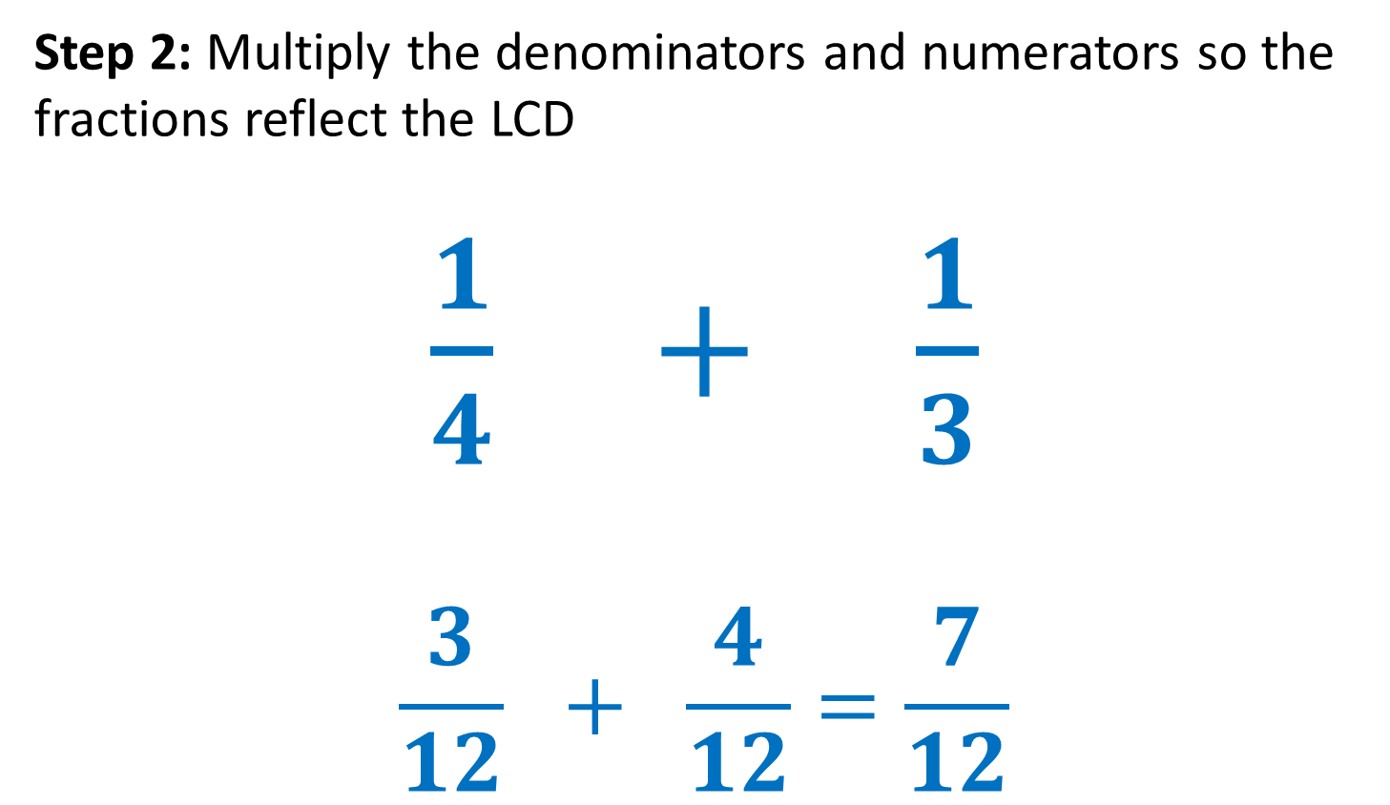
24
7
30
Fractions
Date
EQ – What are the different methods for adding and subtractingfractions?
Finding the Lowest Common Denominator
Step 2: Multiply the denominators and numerators so the fractions reflect the LCD
$\frac{1}{4} + \frac{1}{3}$
$$\frac{3}{12} + \frac{4}{12}=\frac{7}{12}$$

Slide 4
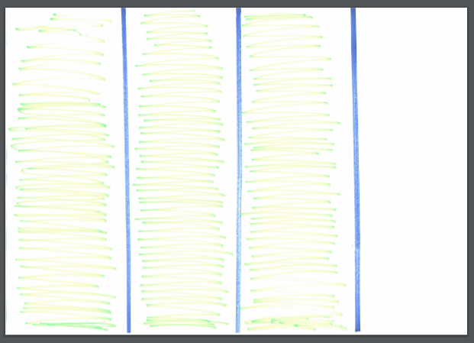
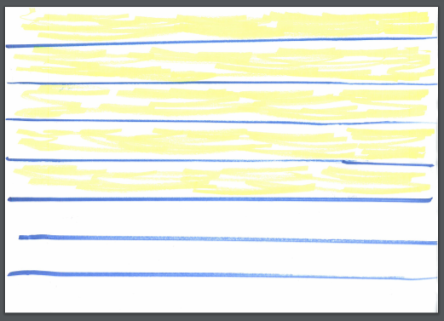
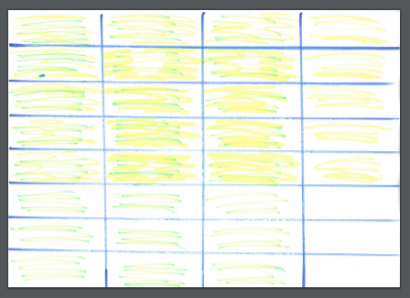
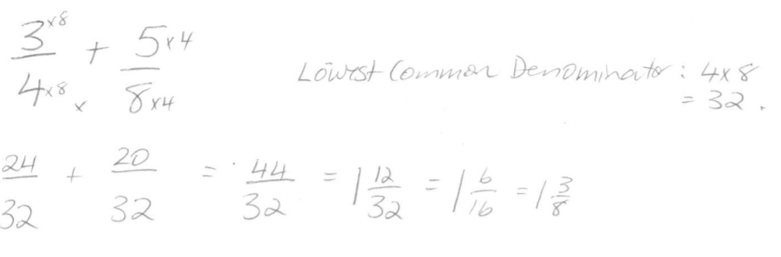
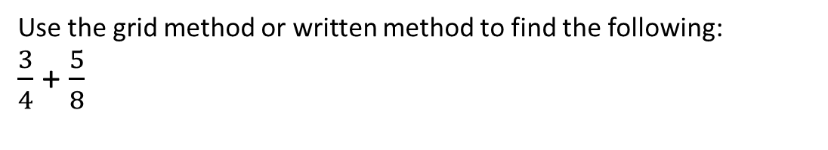
Together
Use the grid method or written method to find the following:
$\frac{3}{4}$ + $\frac{5}{8}$
+
=

Slide 5
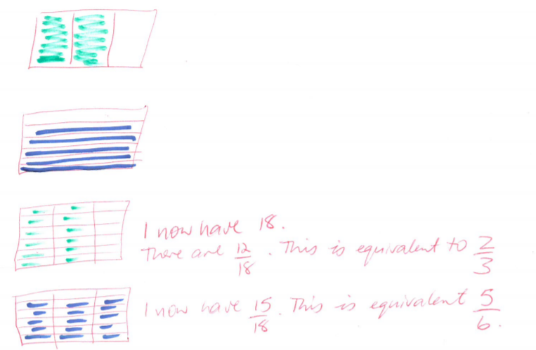
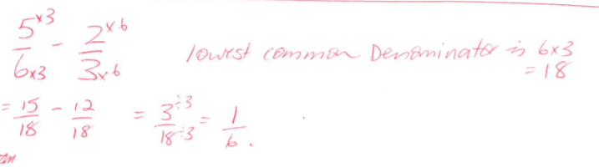
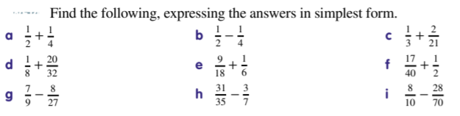
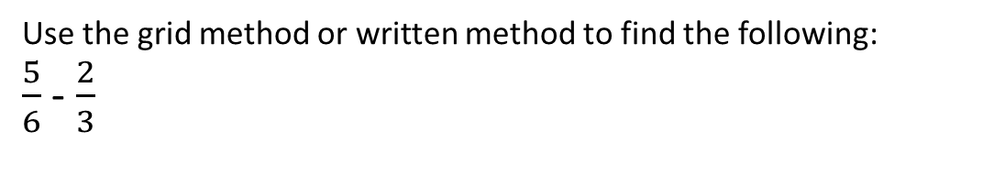
Together
Use the grid method or written method to find the following:
$\frac{5}{6}$ - $\frac{2}{3}$

Slide 6
Practice
Use the grid method or written method to find the following:

Slide 7
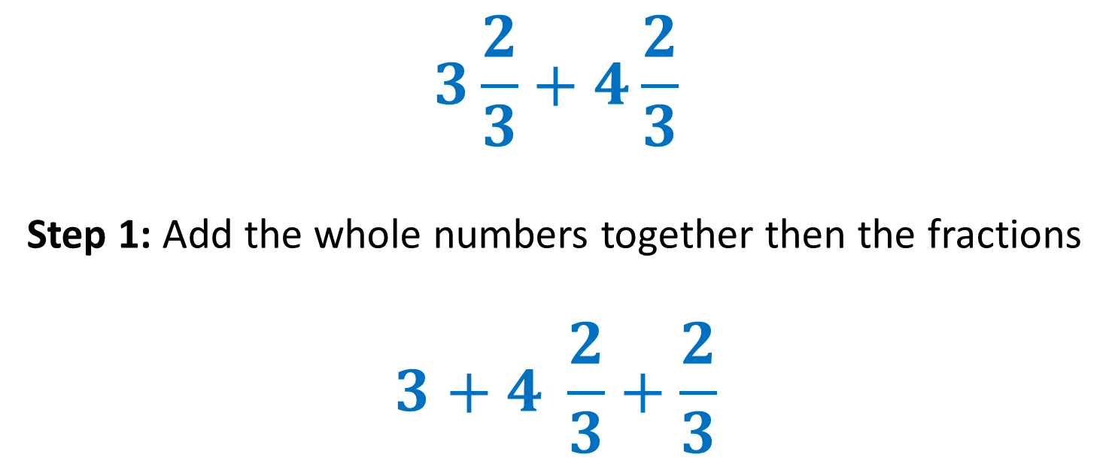
24
7
30
Fractions
Date
EQ – What are the different methods for adding and subtracting mixed numbers?
Method 4
Mixed Numbers
$$3\frac{2}{3}+4\frac{2}{3}$$
Step 1: Add the whole numbers together then the fractions
$$3+4 \frac{2}{3}+\frac{2}{3}$$

Slide 8

24
7
30
Fractions
Date
EQ – What are the different methods for adding and subtracting fractions?
Step 2: Simplify the answer.
$$7 + \frac{4}{3}$$
$$\frac{4}{3}=1\frac{1}{3}$$
$$7 +1\frac{1}{3}=8\frac{1}{3}$$
Method 4
Mixed Numbers

Slide 9
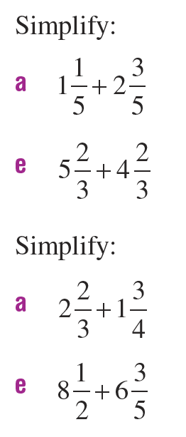
Practice

